Slide 1
Cost of Living in the United States (2023)

Slide 2
TABLE OF CONTENTS
01
02
03
04
05
Background
Dataset
Problem Statement
Visualizations & Analysis
Conclusions

Slide 3
01
Background

Slide 4
Cost of Living
What is
“Cost of Living”?
What is it composed of?
What's
its purpose?
A metric that represents the financial amount required to maintain a specific lifestyle standard in a particular place and time
Made up of expenses that are part of our daily lives, including housing, food, taxes, healthcare, education, and transportation
Provides individuals, families, and policymakers with valuable insights into the financial requirements necessary to meet basic needs and maintain a certain standard of living

Slide 5

Rise in Cost of Living
1
Inflation is the gradual increase in prices for goods and services over time and has played a significant role in the rise of cost of living
Inflation reduces the purchasing power of our currency, which means that the same amount of money buys us less than it used to.
Inflation rates can vary from year to year, but the general trend is upward.
2
3

Slide 6
Why is this important?
Understanding the factors driving the rise in the cost of living is pivotal to making informed decisions about our financial future. As we further discuss cost of living in the US, keep these factors in mind as they have direct implications for our quality of life.

Slide 7
02
Dataset

Slide 8
Dataset
US Cost of Living Dataset (1877 Counties)
Contains cost of living information for 1877 US counties
31,430 unique entries, 15 columns
It includes data such as case ID, state, metropolitan status, county, family member count, costs for housing, food, transportation, healthcare, other necessities, childcare, taxes, total cost, and median family income
MYHOME

Slide 9


Tools Used
Data Manipulation
Data Visualization

Slide 10
Data Cleaning Process
01
02
03
04
Data Constraints
Text and Categorical Data Problems
Data Uniformity Problems
Missing Data Problems

Slide 11
Data Cleaning
Data Constraints
Text and Categorical
Ensured that each column had the correct data types. For our dataset, that meant costs should have numerical data, and the states, counties, and metropolitan status have categorical data.
Ensured that categorical columns were consistent. For example, the states should always be abbreviated to two letters, and the counties should all follow the same format.

Slide 12
Data Cleaning
Data Uniformity
Missing Data
Converted the dataset values, which ranged from 1 to 5 decimal places, to a uniform representation of 2 decimal places, making them suitable for financial applications.
Identified a missing median family income for Sullivan County during our dataset review and analysis. We used Data USA to get the median family income of $46,964.
UPDATE cost_of_living_us
SET food_cost = ROUND(food_cost,2);
UPDATE cost_of_living_us
SET median_family_income = 46964
WHERE county = 'Sullivan';
* changed “food_cost” for the different columns

Slide 13
03
Problem Statement

Slide 14
Problem Statement
How can we assist financially conscious individuals or families based on their specific living arrangements, in identifying the most cost-effective and appropriate states/counties to reside in.

Slide 15
04
Visualizations & Analysis

Slide 16
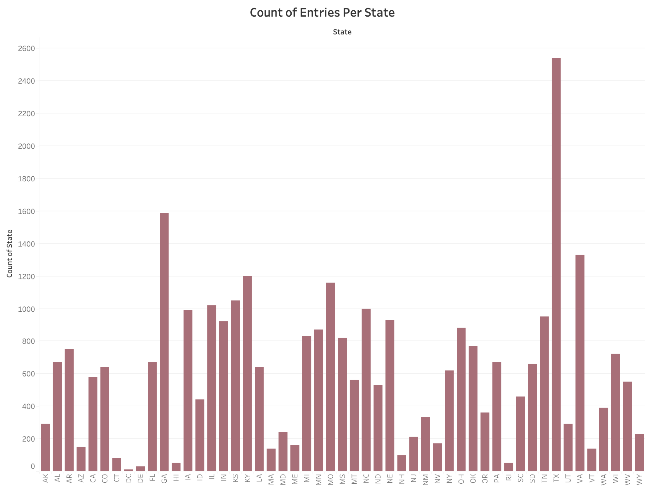
Avg. Number of Entries Per State:
616

Slide 17
Which states are considered the least favorable for individuals and families in terms of total cost of living?

Slide 18
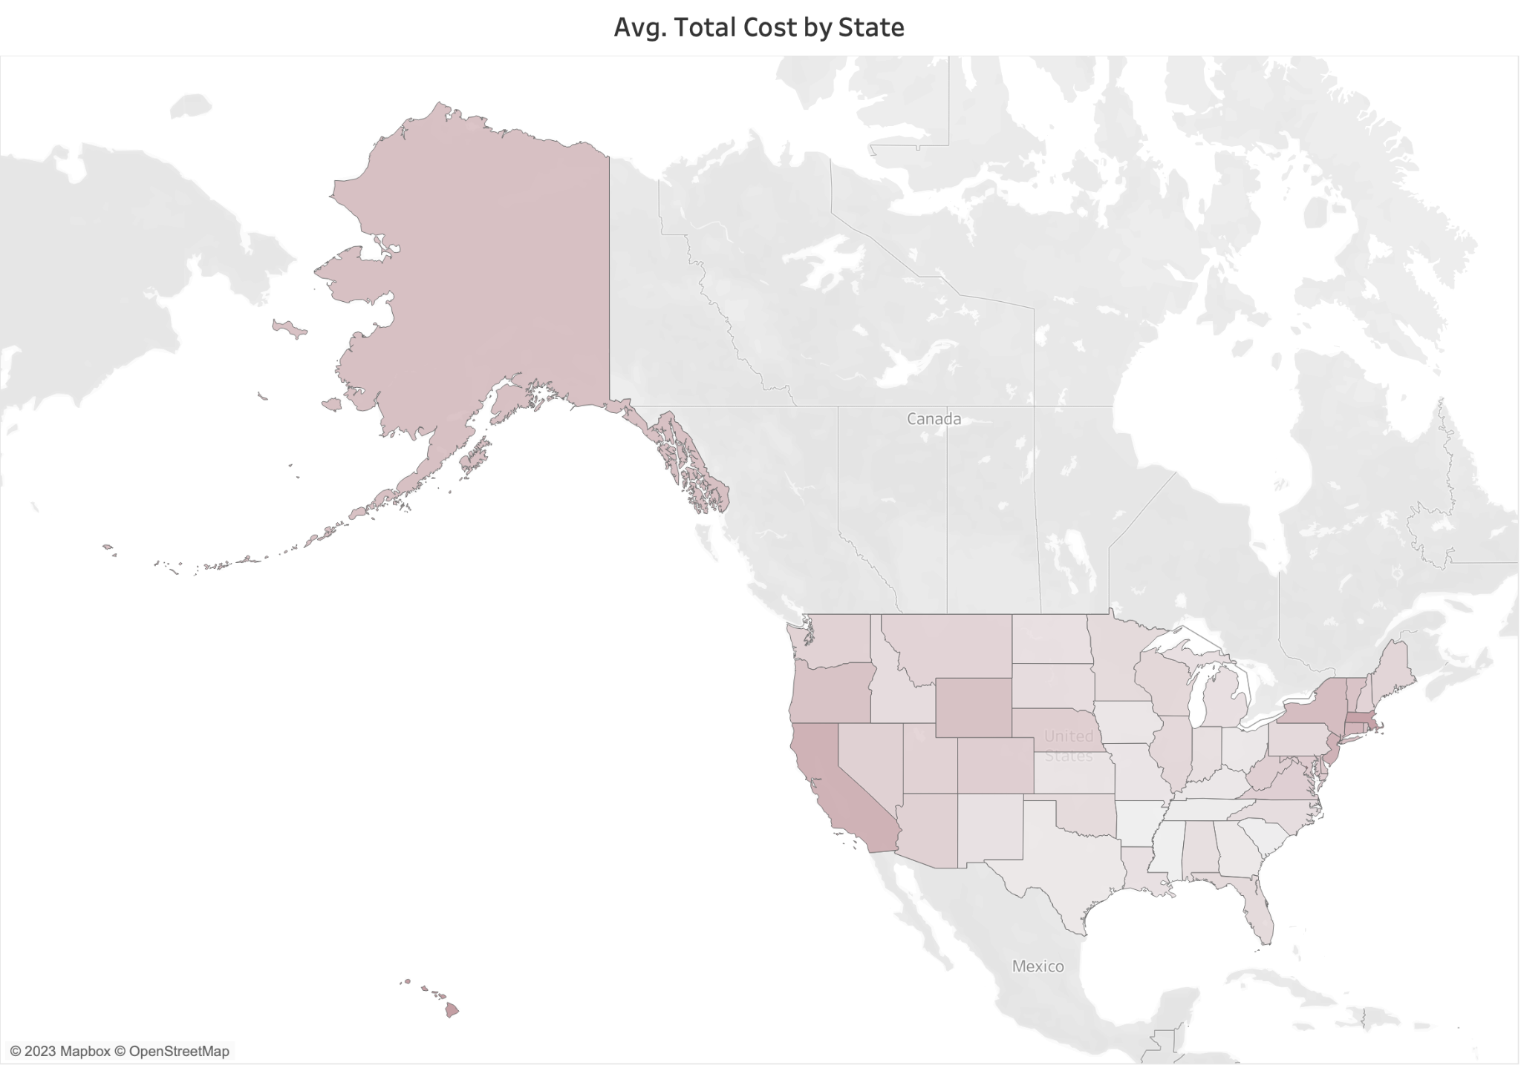
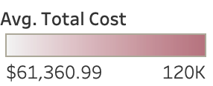

Slide 19
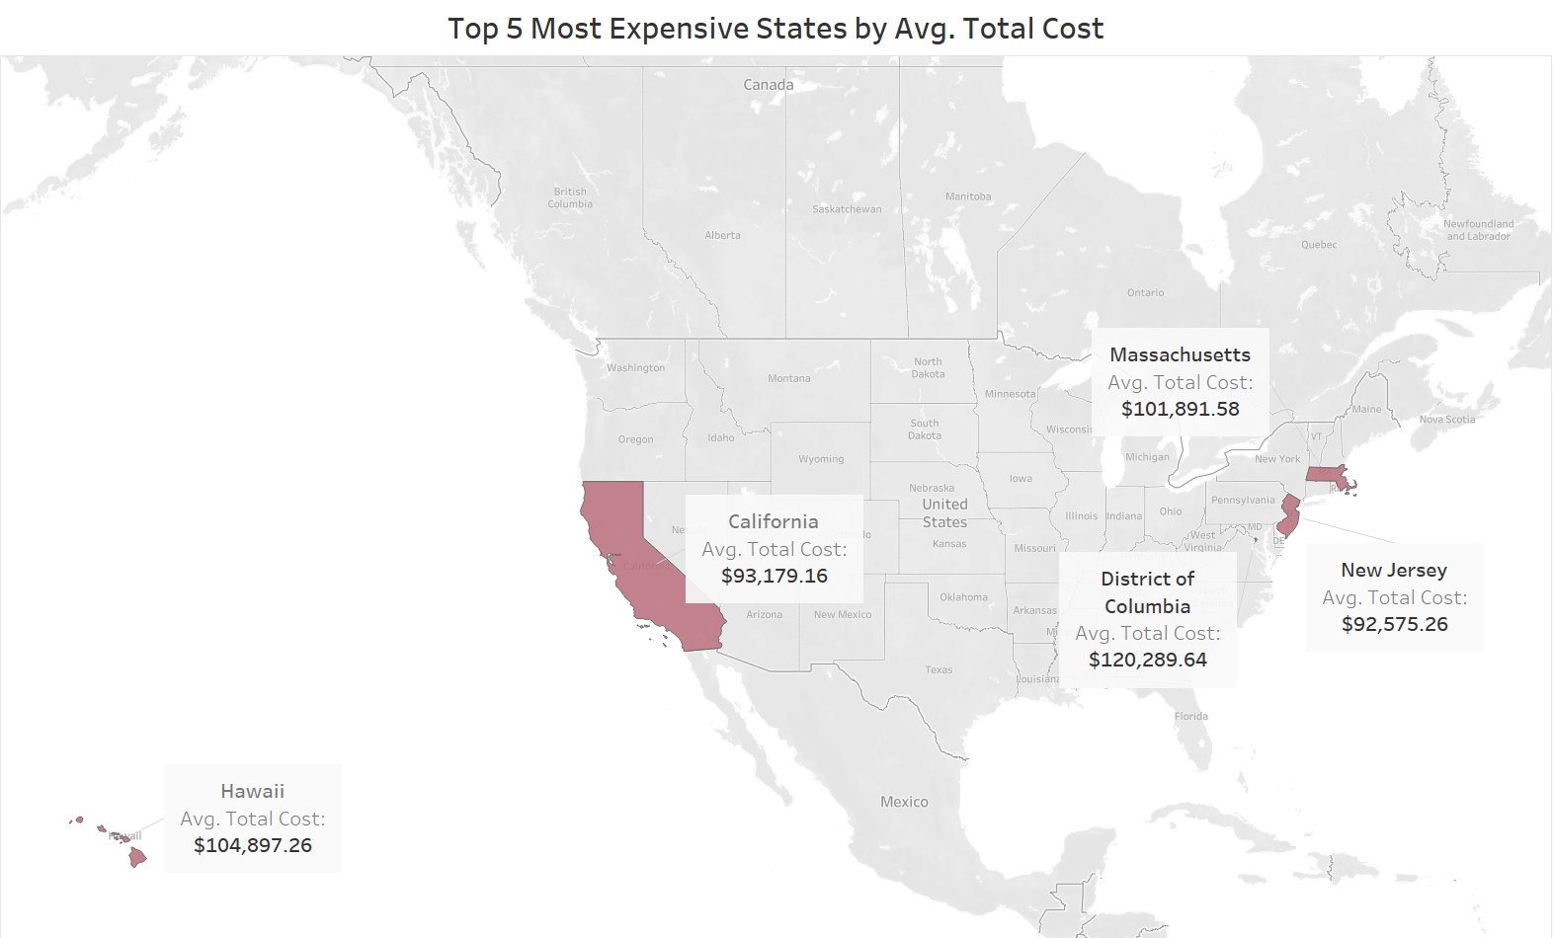

Slide 20
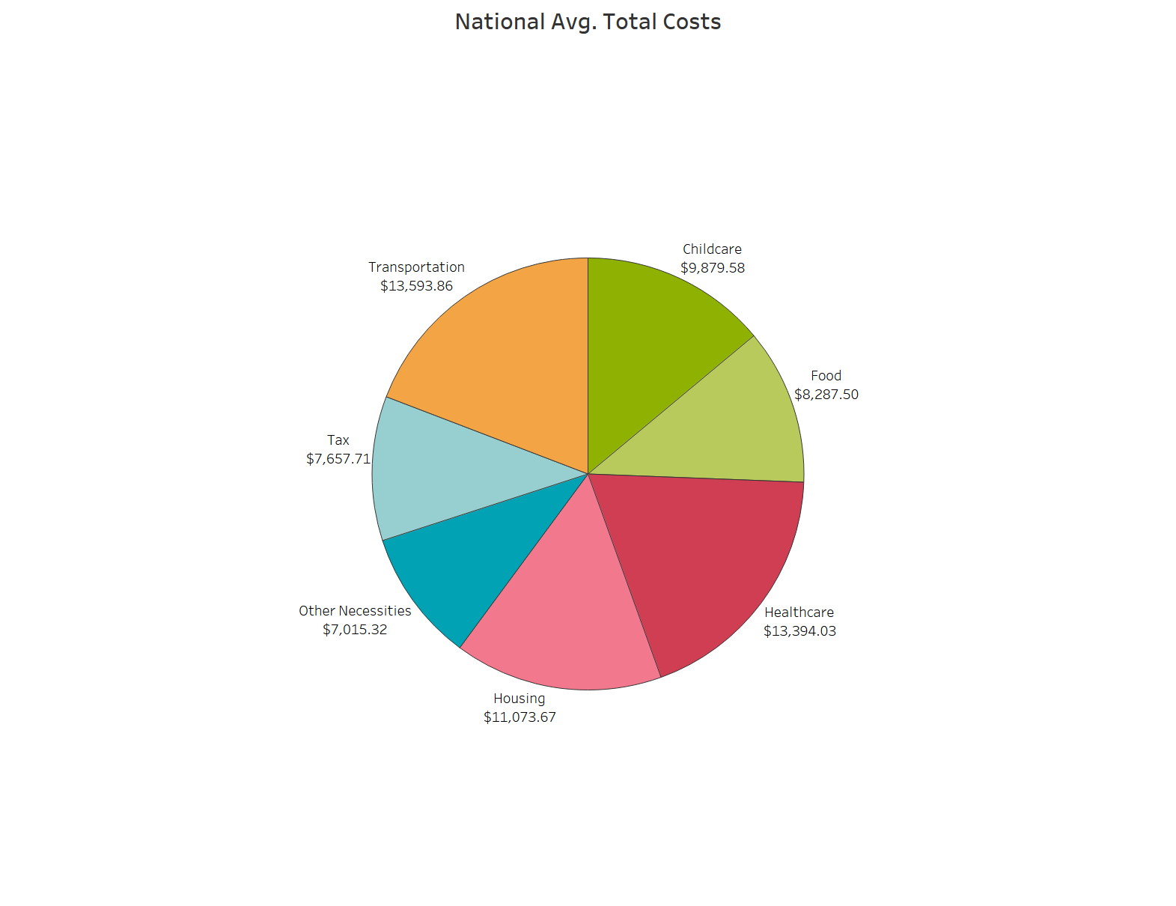
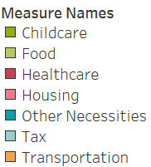
National Avg. Total Cost:
$70,901.68

Slide 21
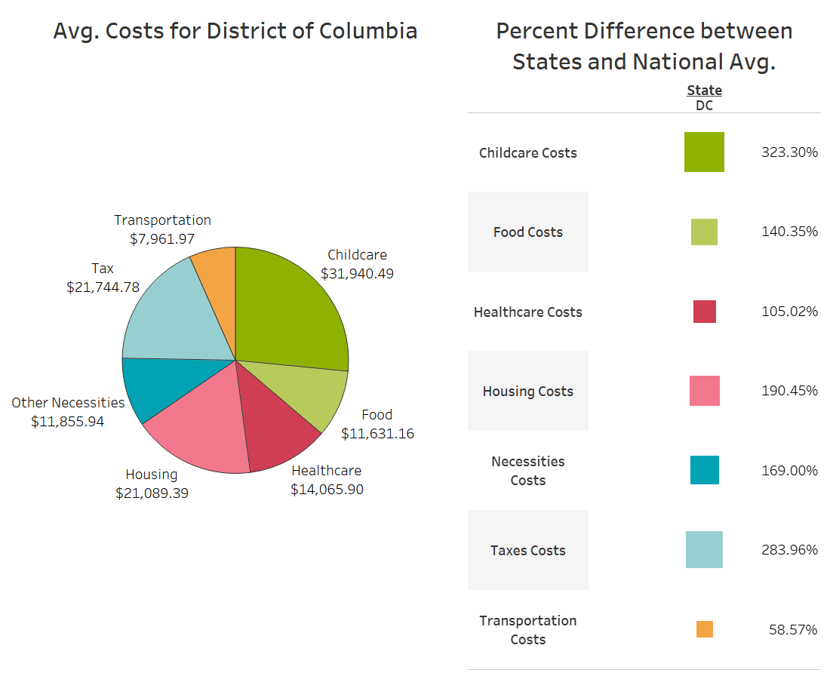
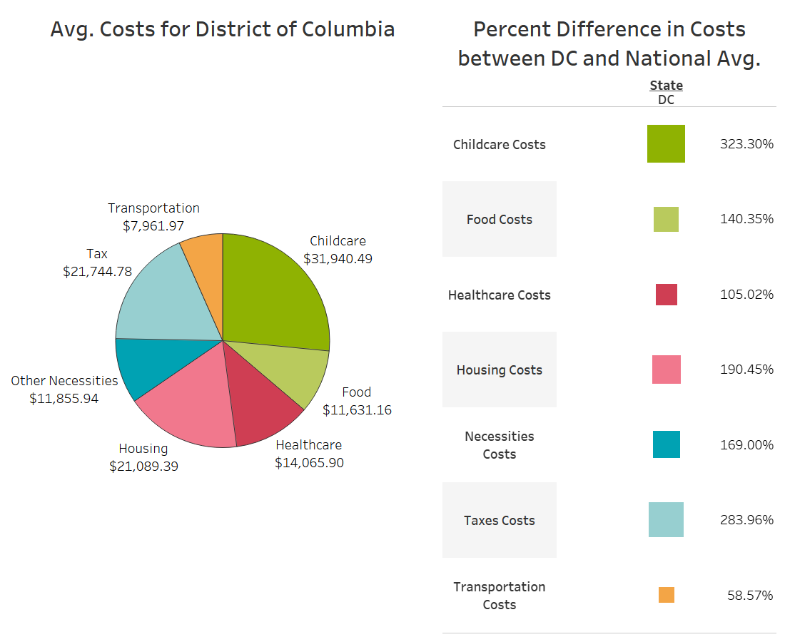

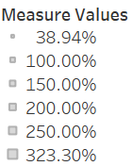
DC Avg. Total Cost:
$120,289.64

Slide 22
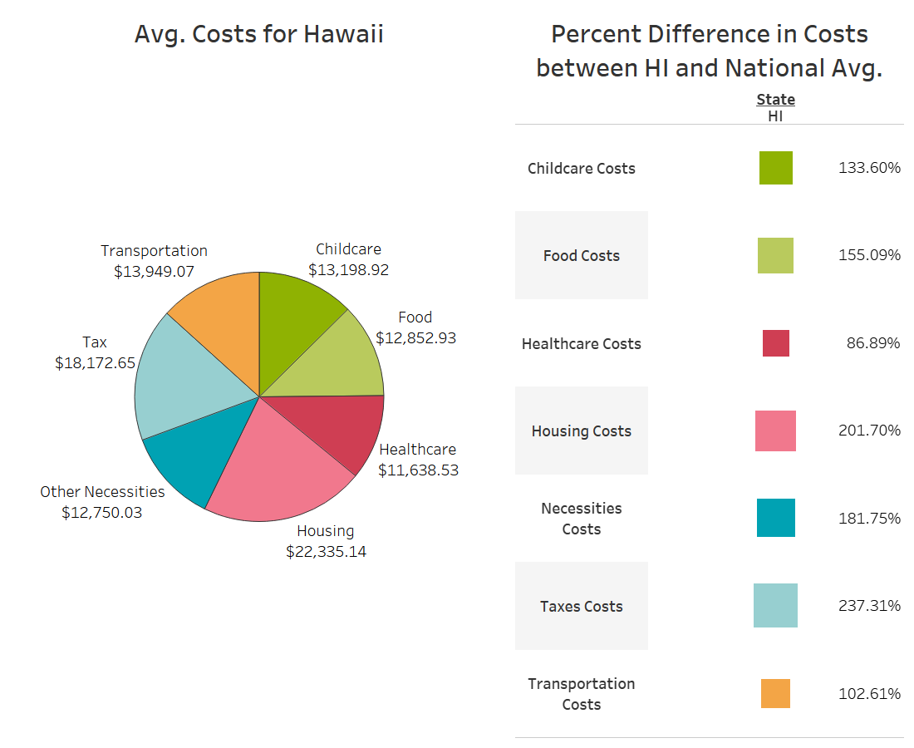

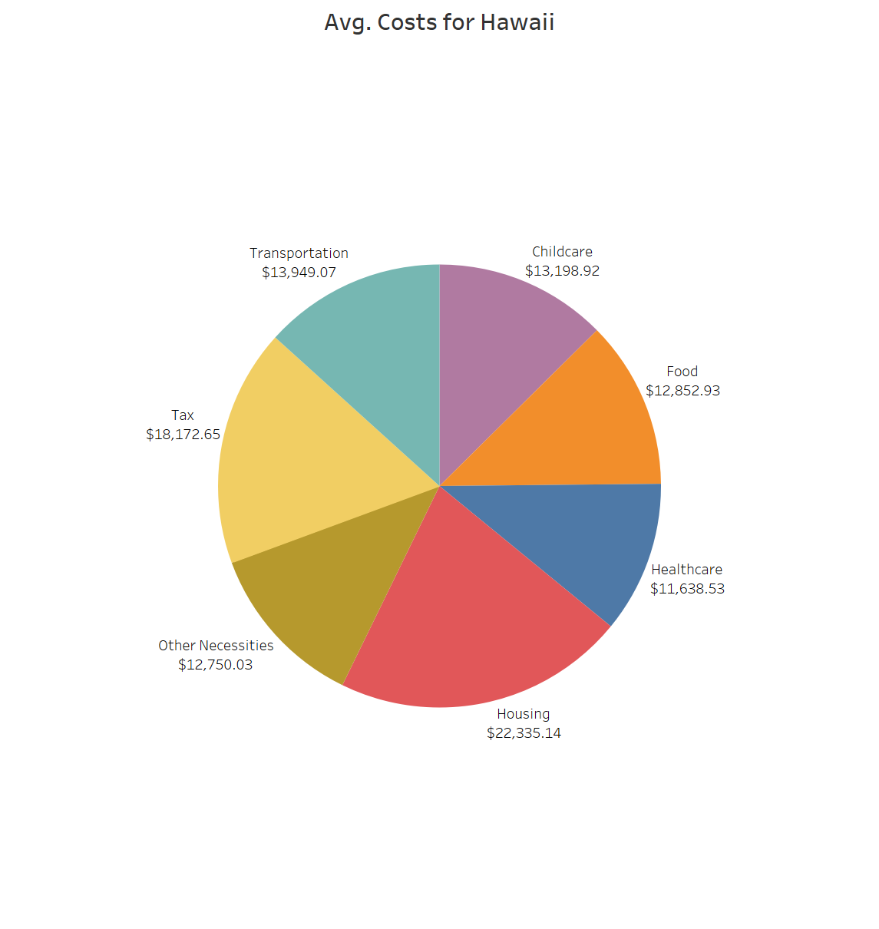
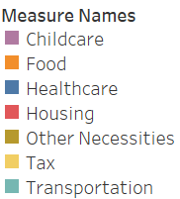
HI Avg. Total Cost:
$104,897.26

Slide 23
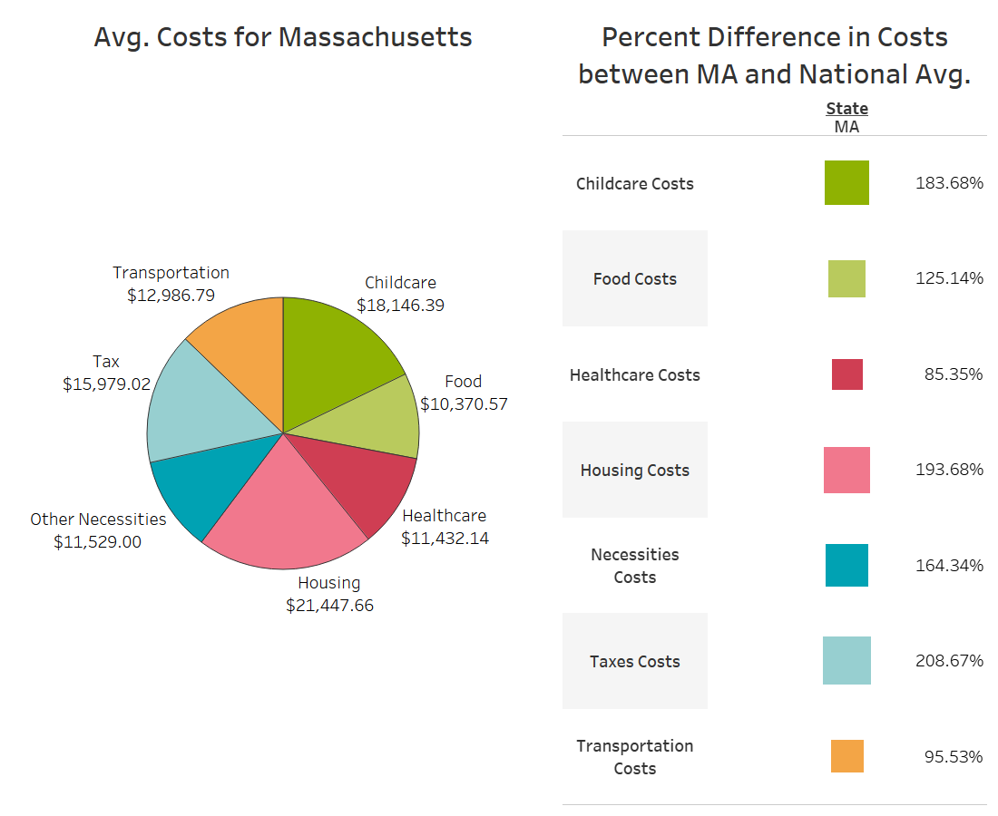

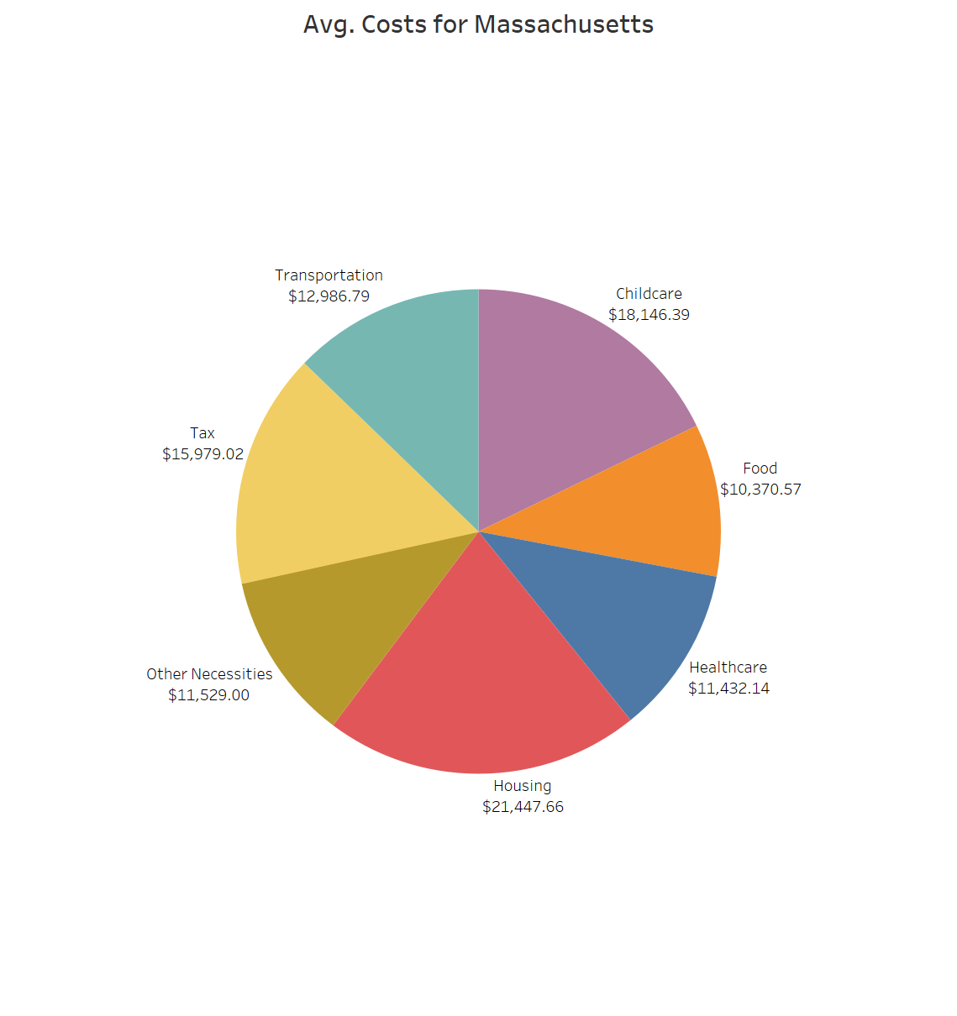
MA Avg. Total Cost:
$101,891.58

Slide 24
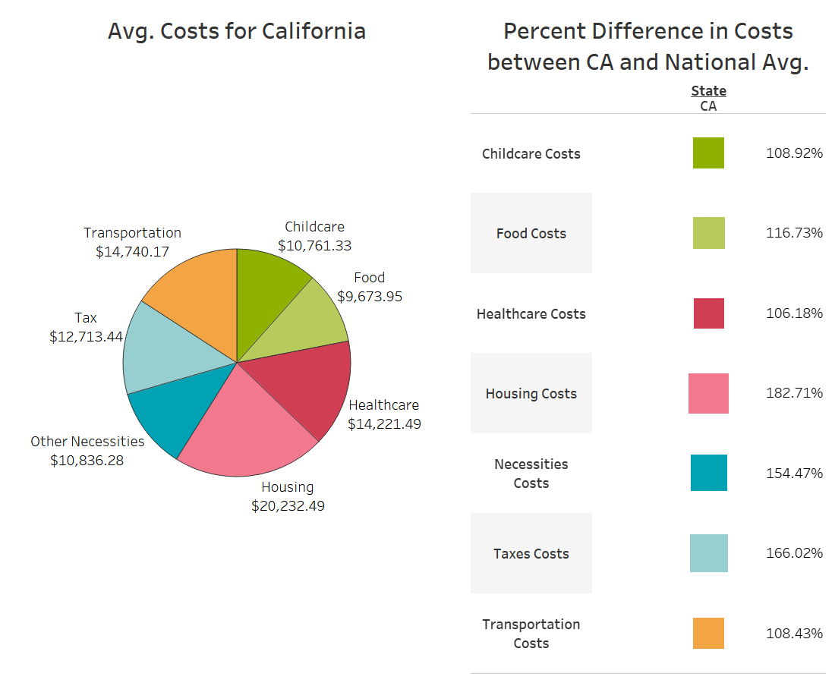

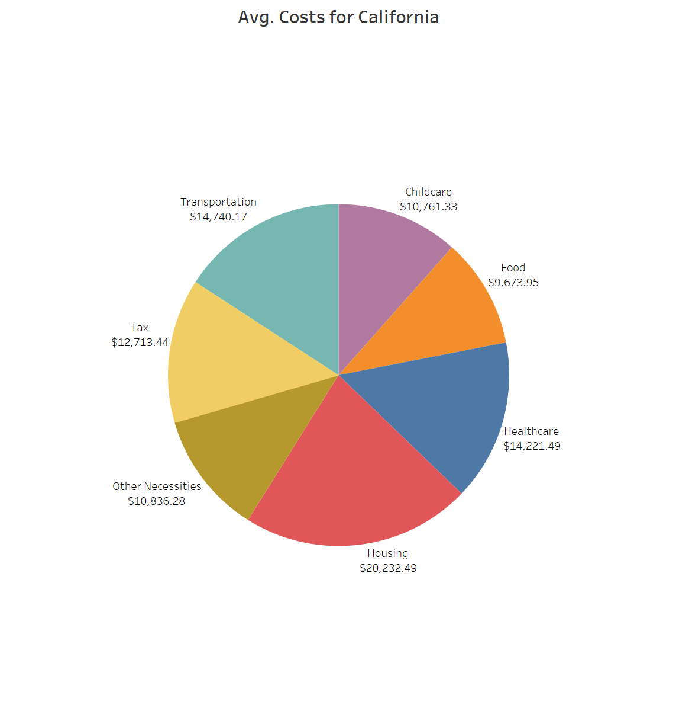
CA Avg. Total Cost:
$93,179.16

Slide 25
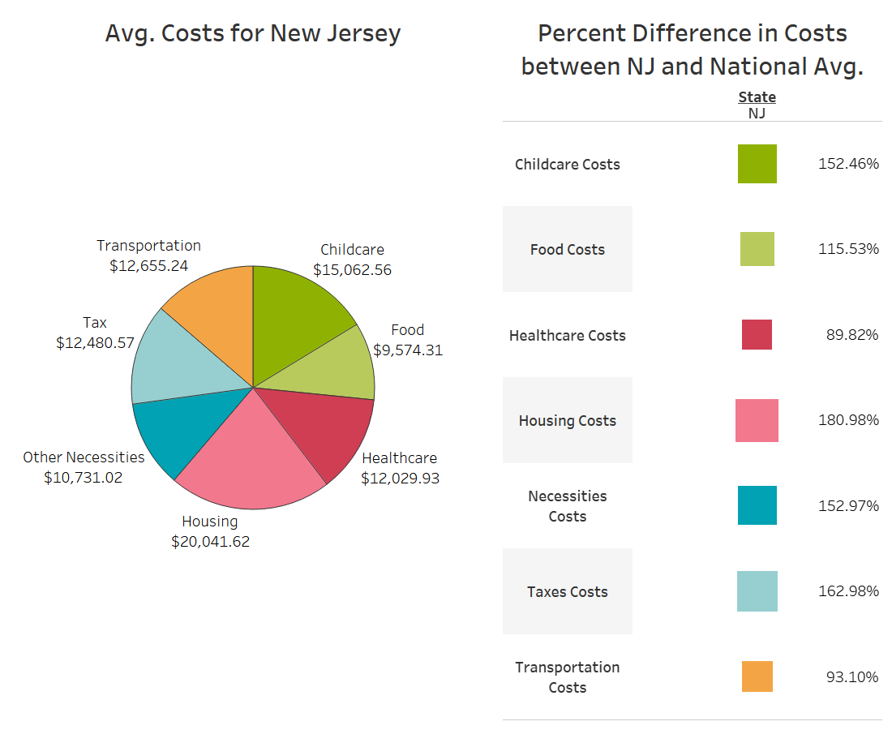
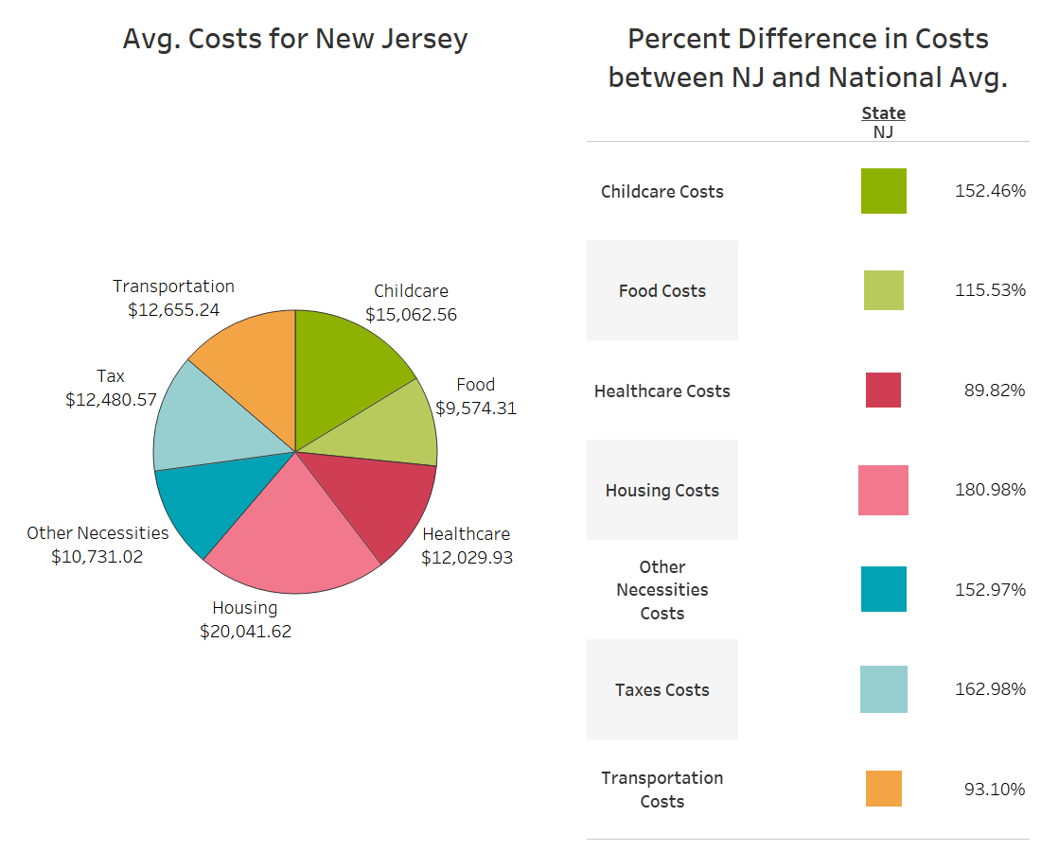
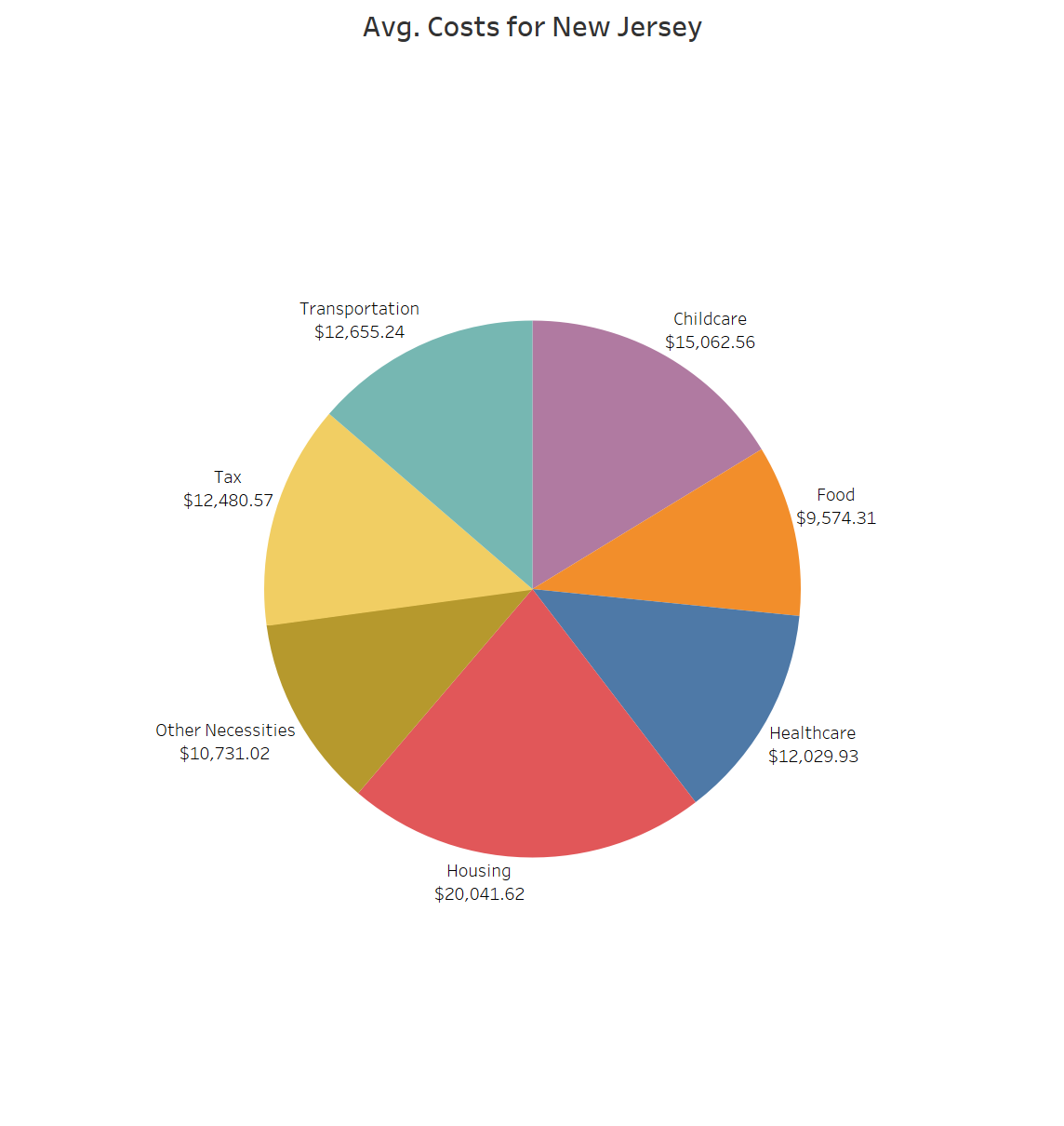
NJ Avg. Total Cost:
$92,575.26

Slide 26
Which states are considered the most favorable for individuals and families in terms of living cost based on their respective family sizes?

Slide 27
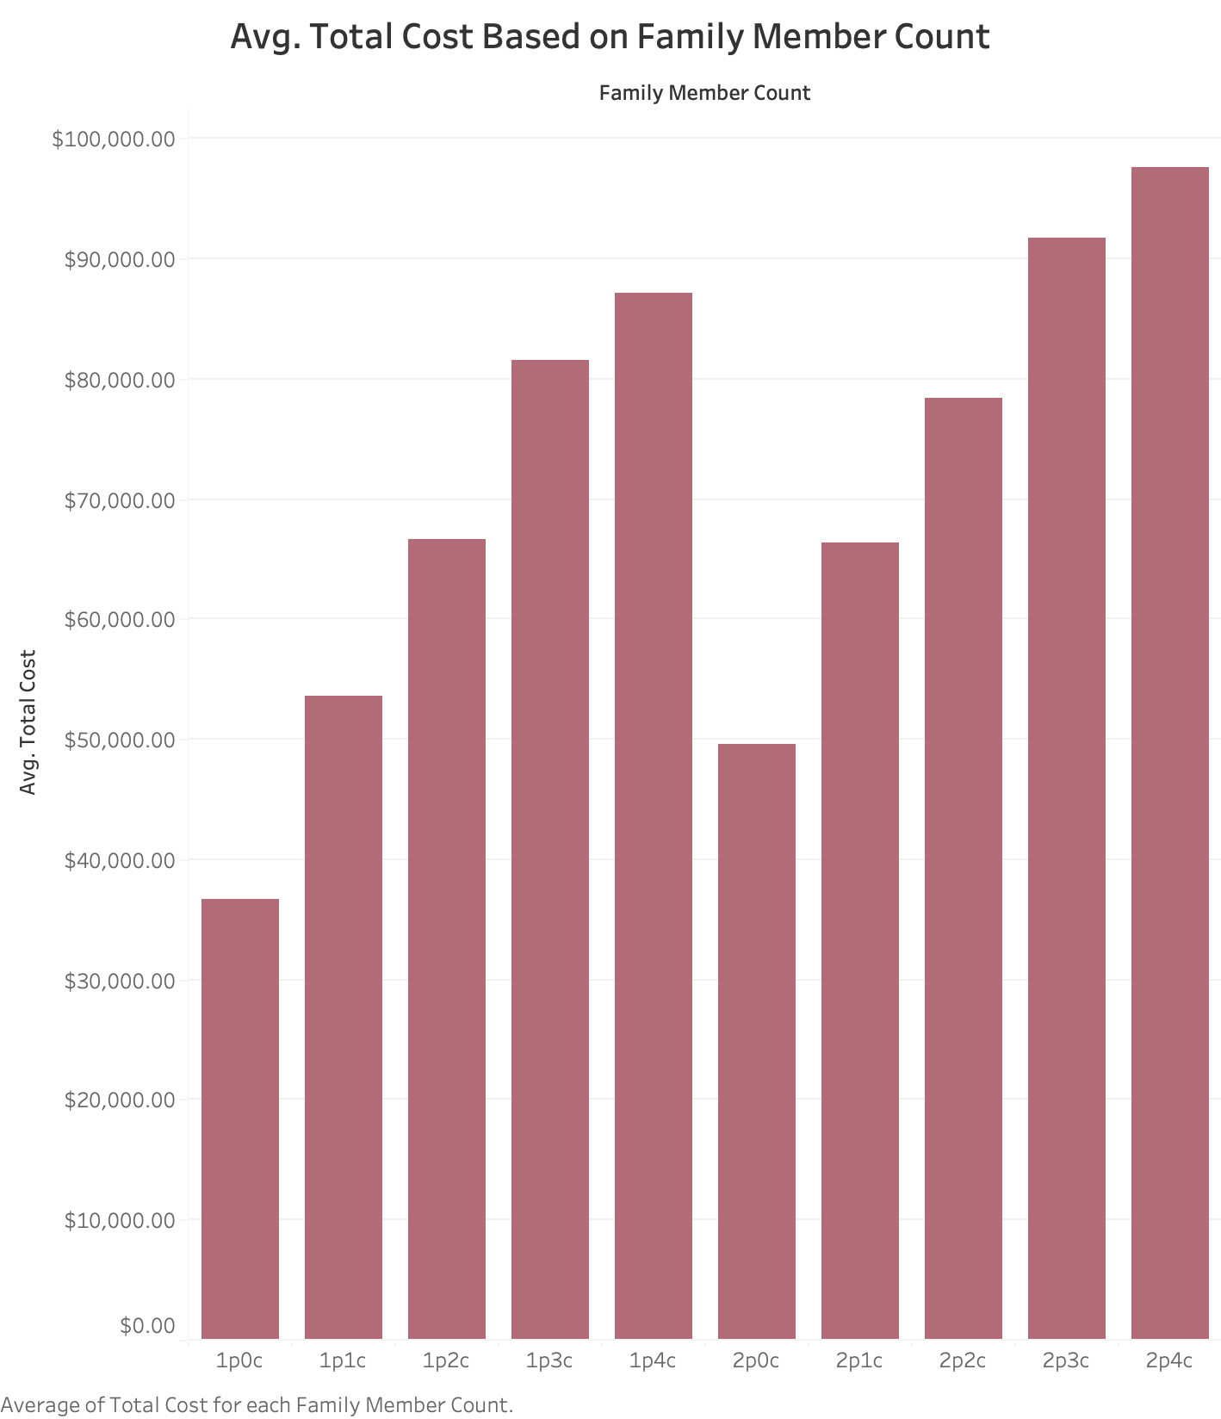
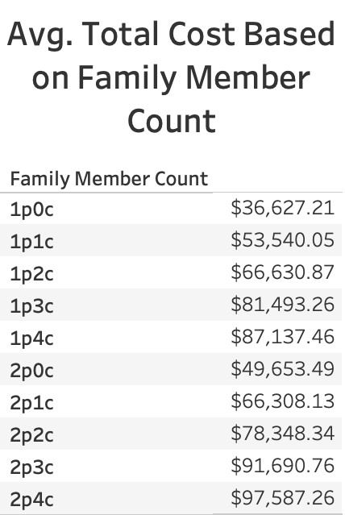
Legend (#p#c):
#p - number of adults
#c - number of children

Slide 28
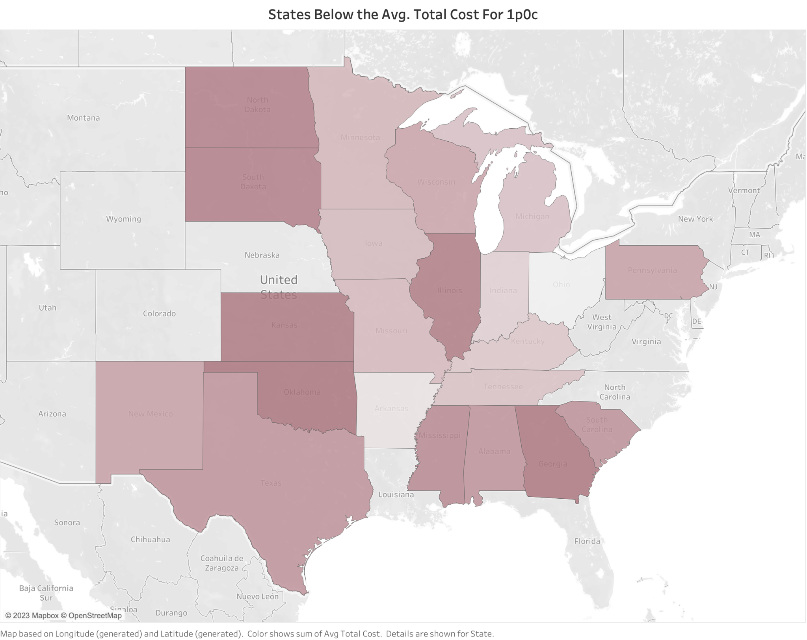
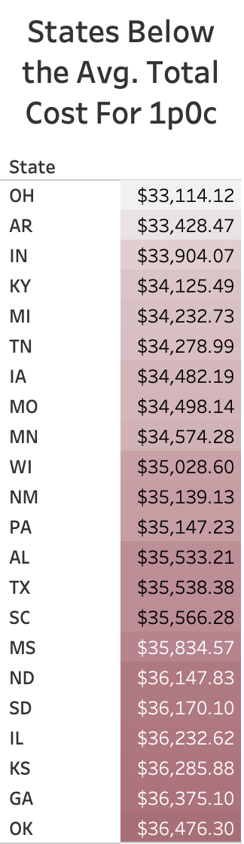
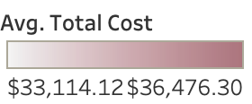
Avg. Total Cost for 1p0c:
$36,627.21

Slide 29
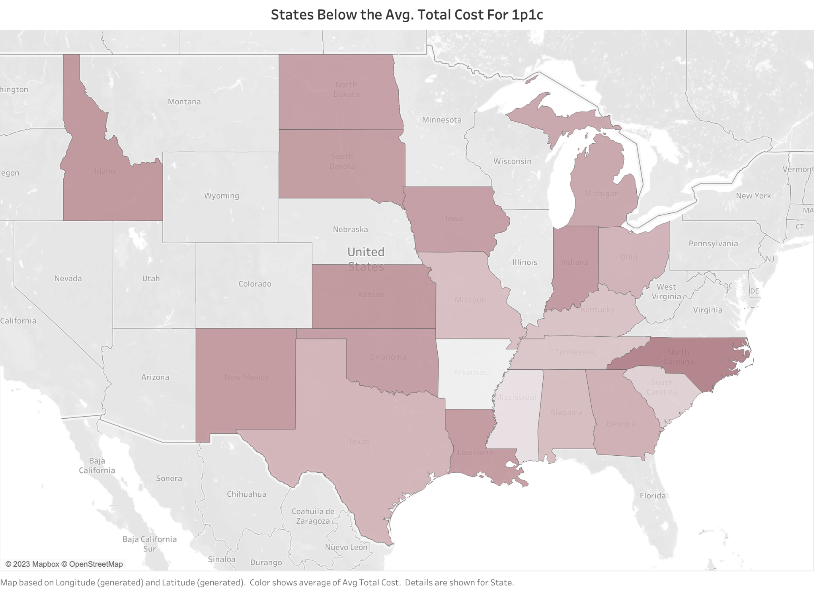
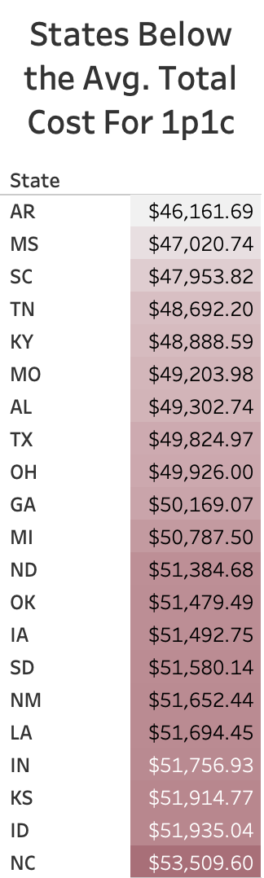

Avg. Total Cost for 1p1c:
$53,540.05

Slide 30
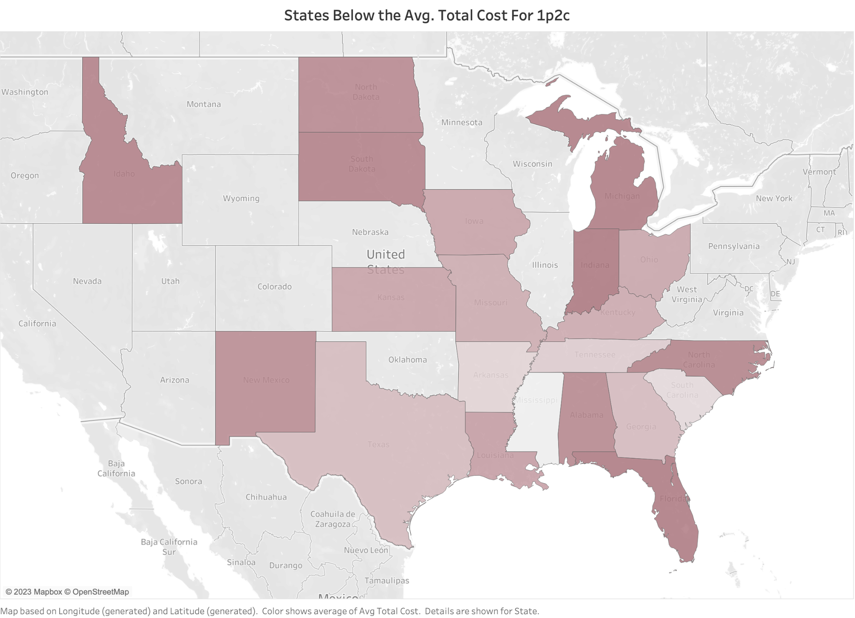
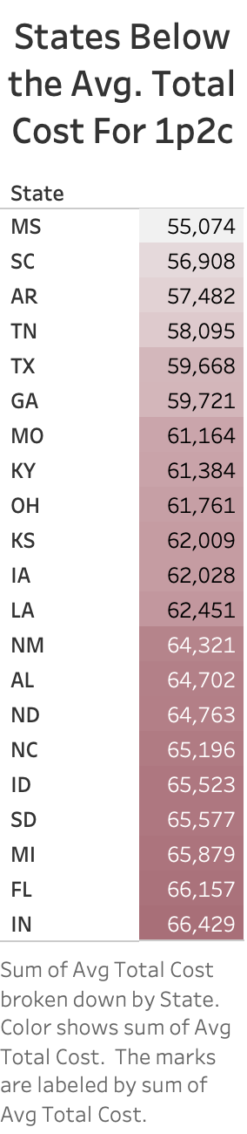
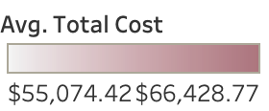
Avg. Total Cost for 1p2c:
$66,630.87

Slide 31
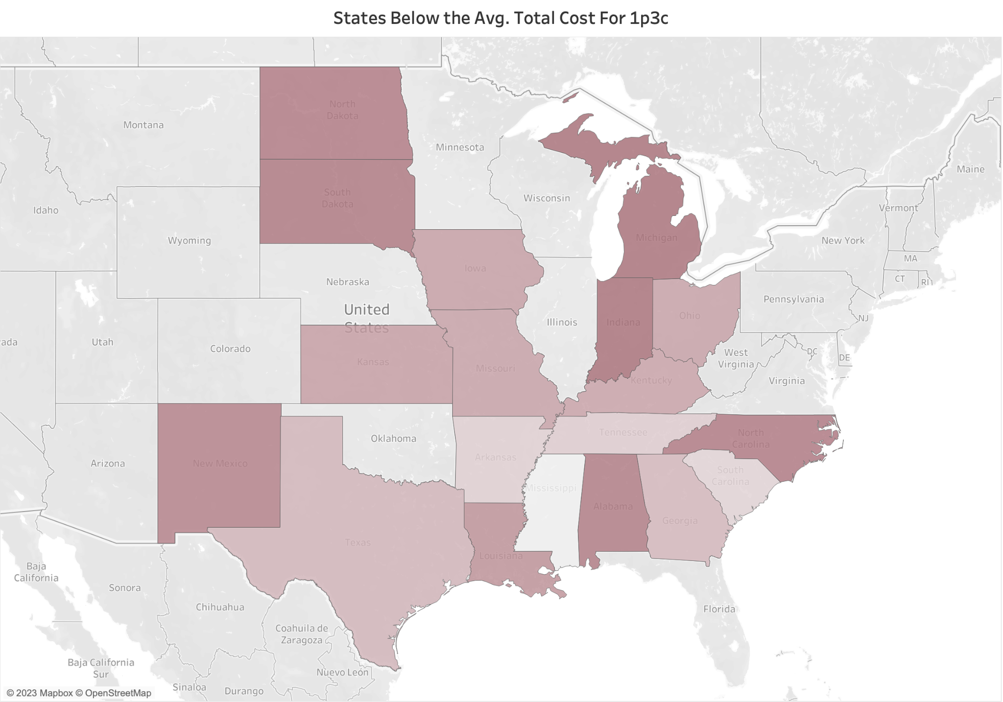
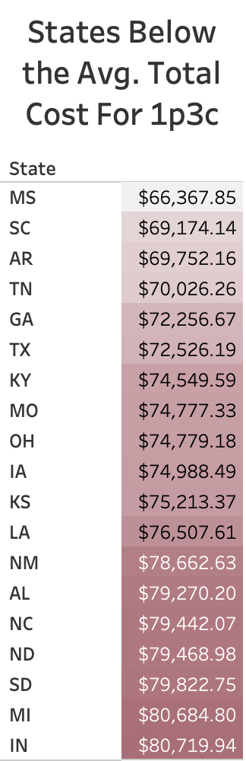
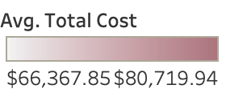
Avg. Total Cost for 1p3c:
$81,493.26

Slide 32
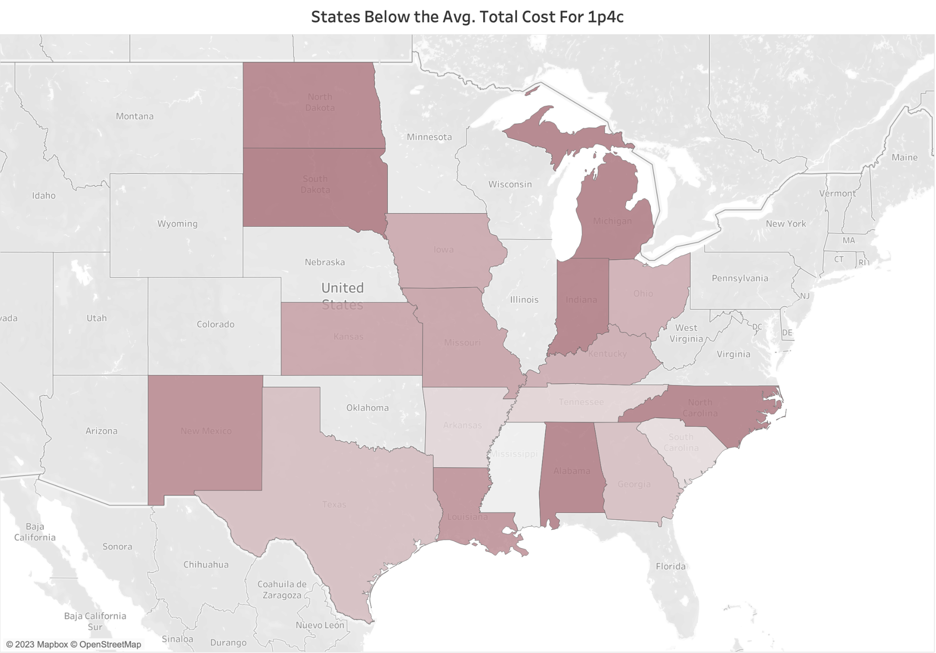
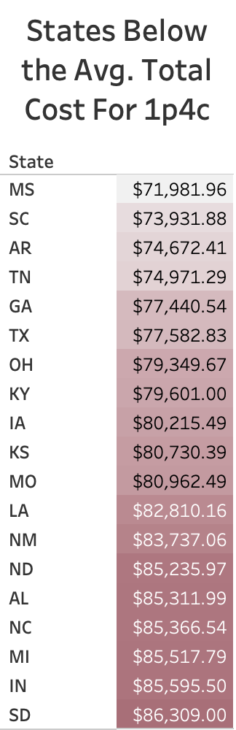
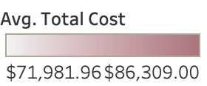
Avg. Total Cost for 1p4c:
$87,137.46

Slide 33
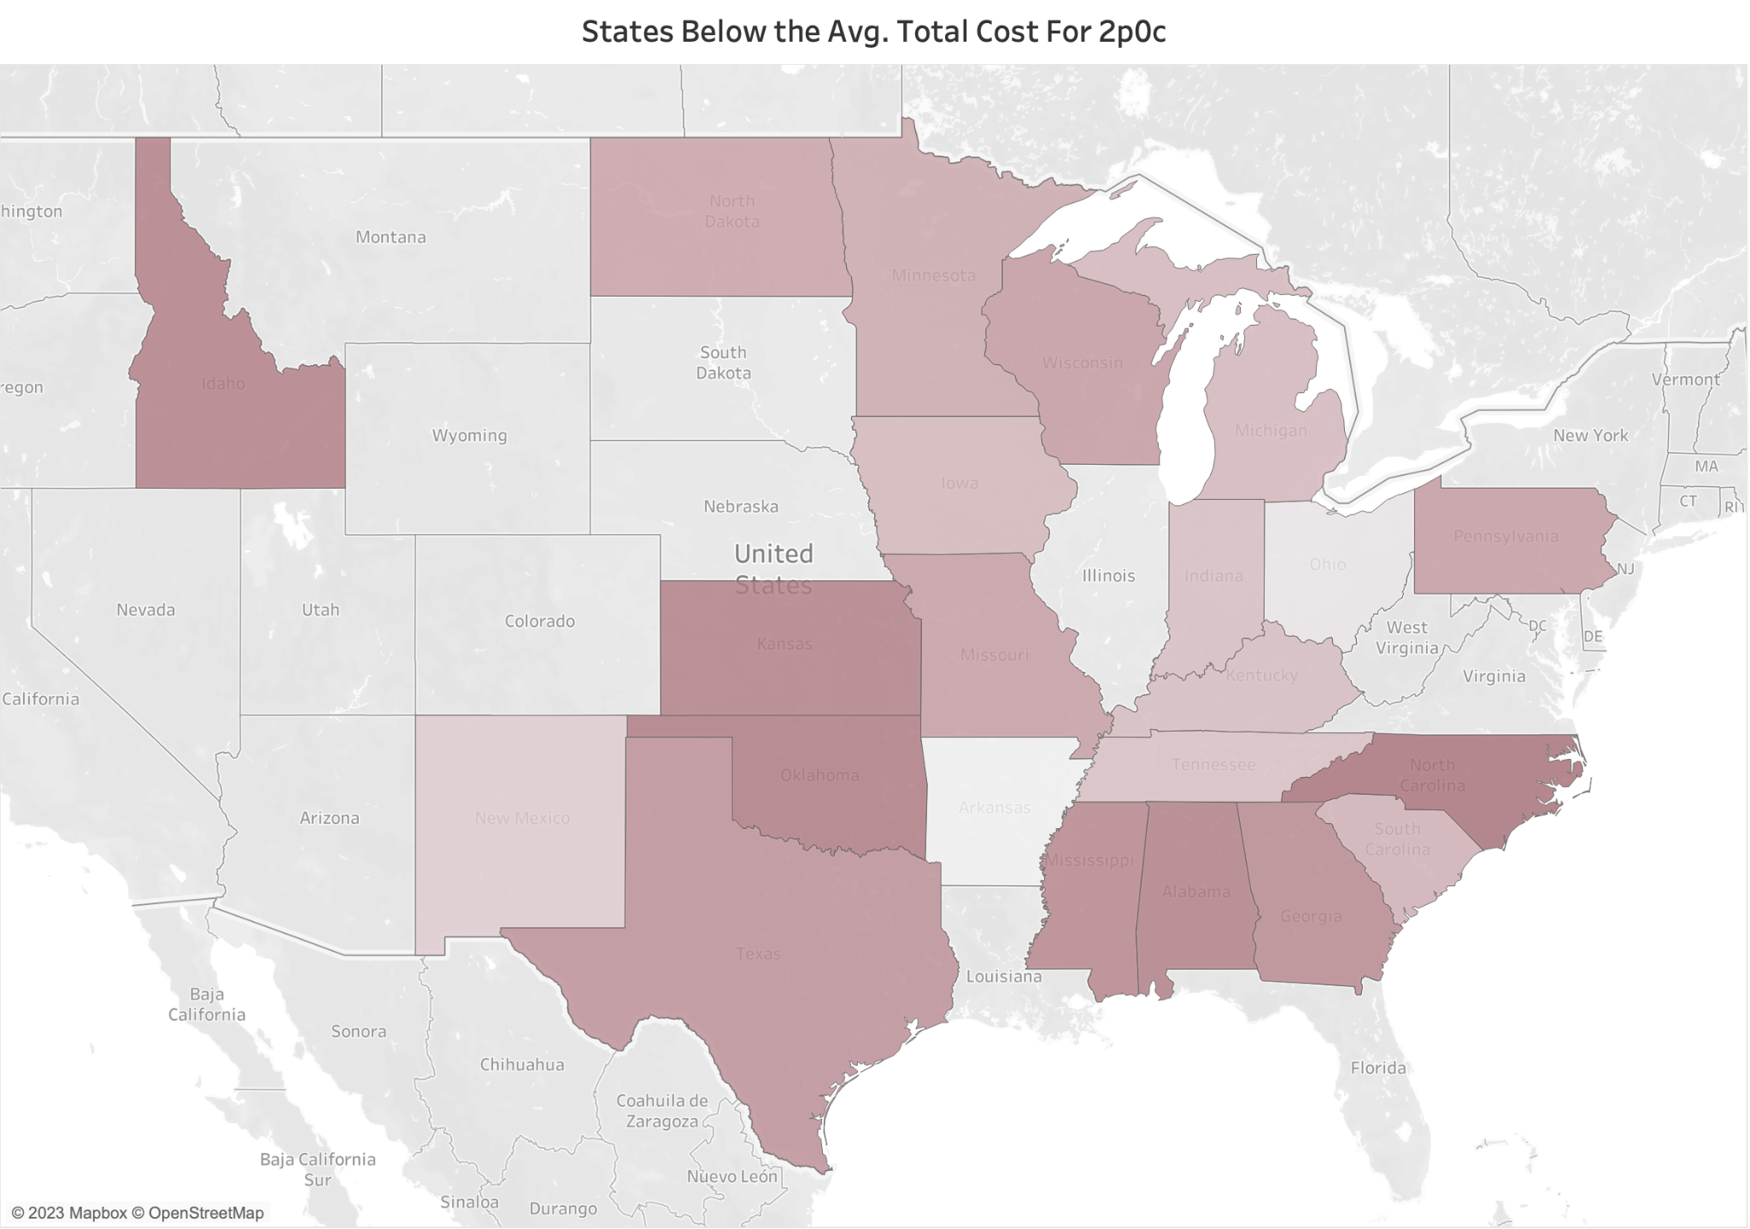
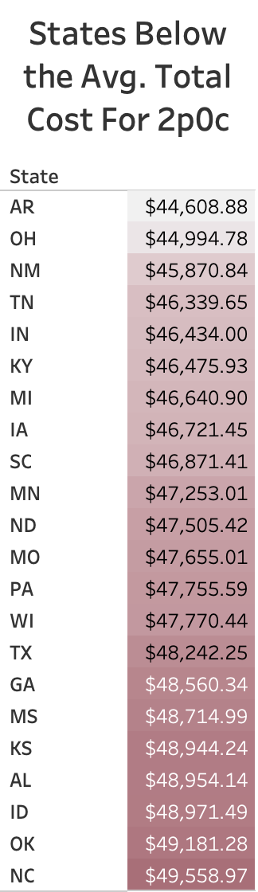
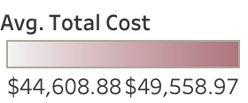
Avg. Total Cost for 2p0c:
$49,653.49

Slide 34
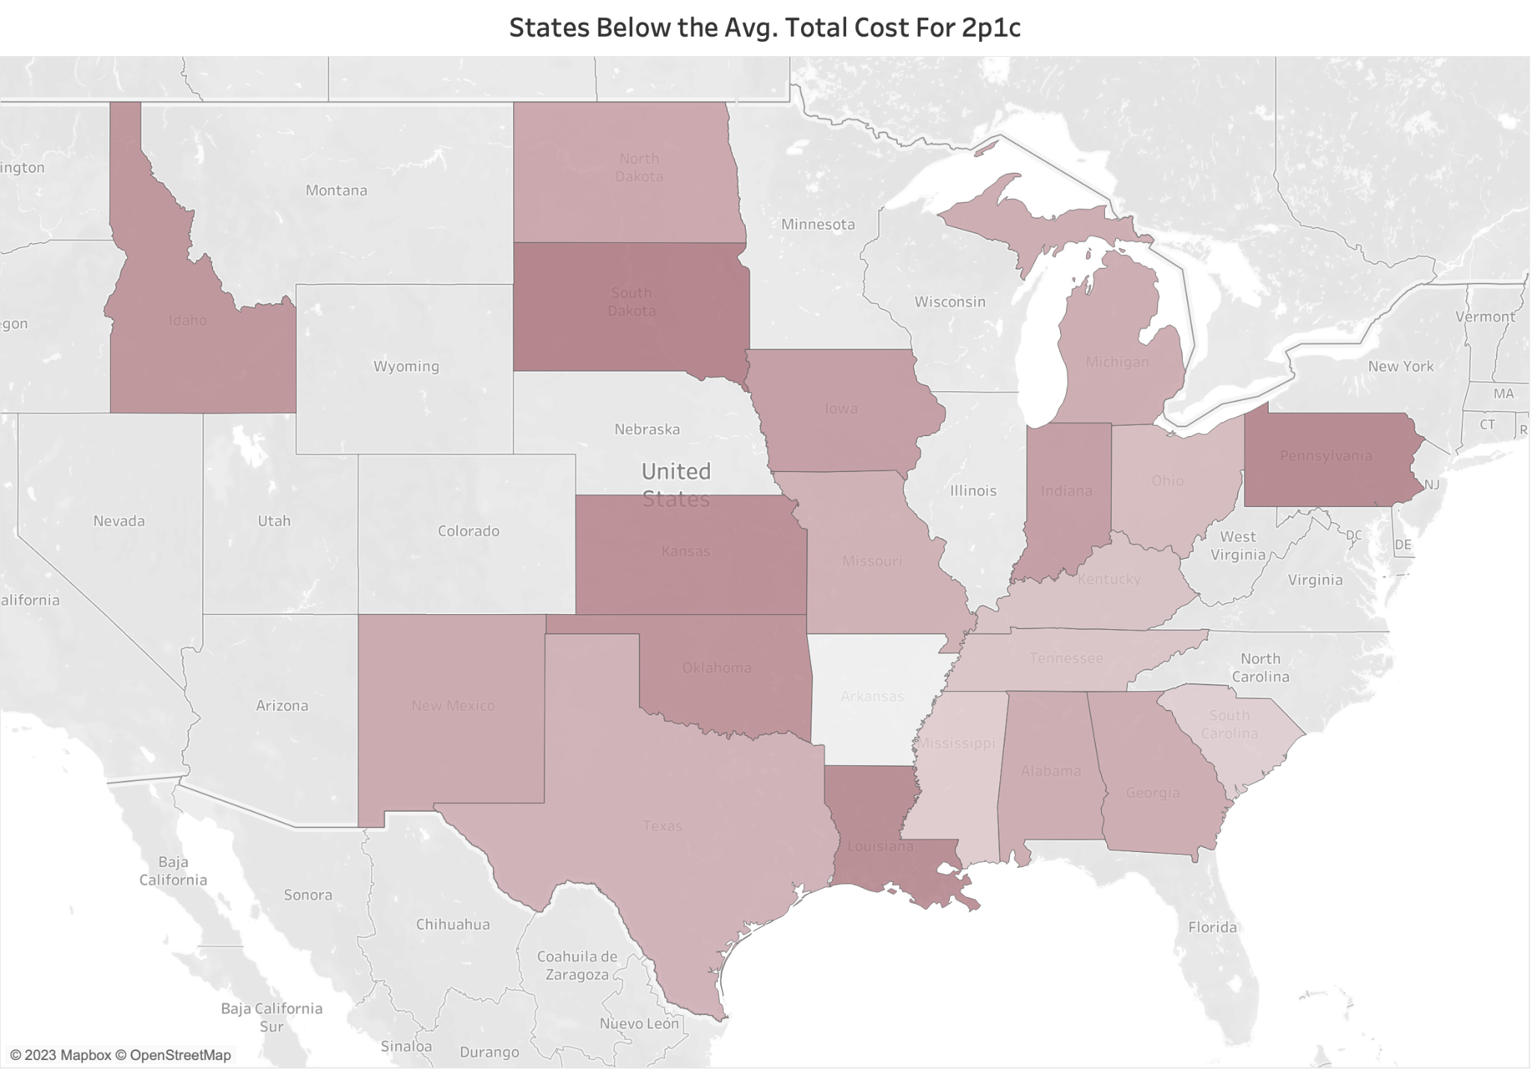
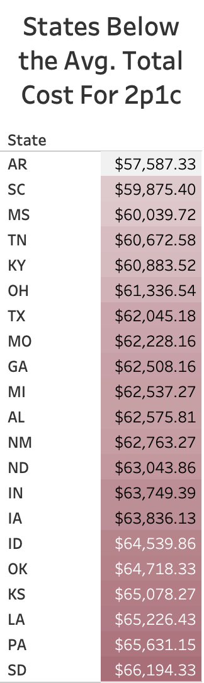

Avg. Total Cost for 2p1c:
$66,308.13

Slide 35
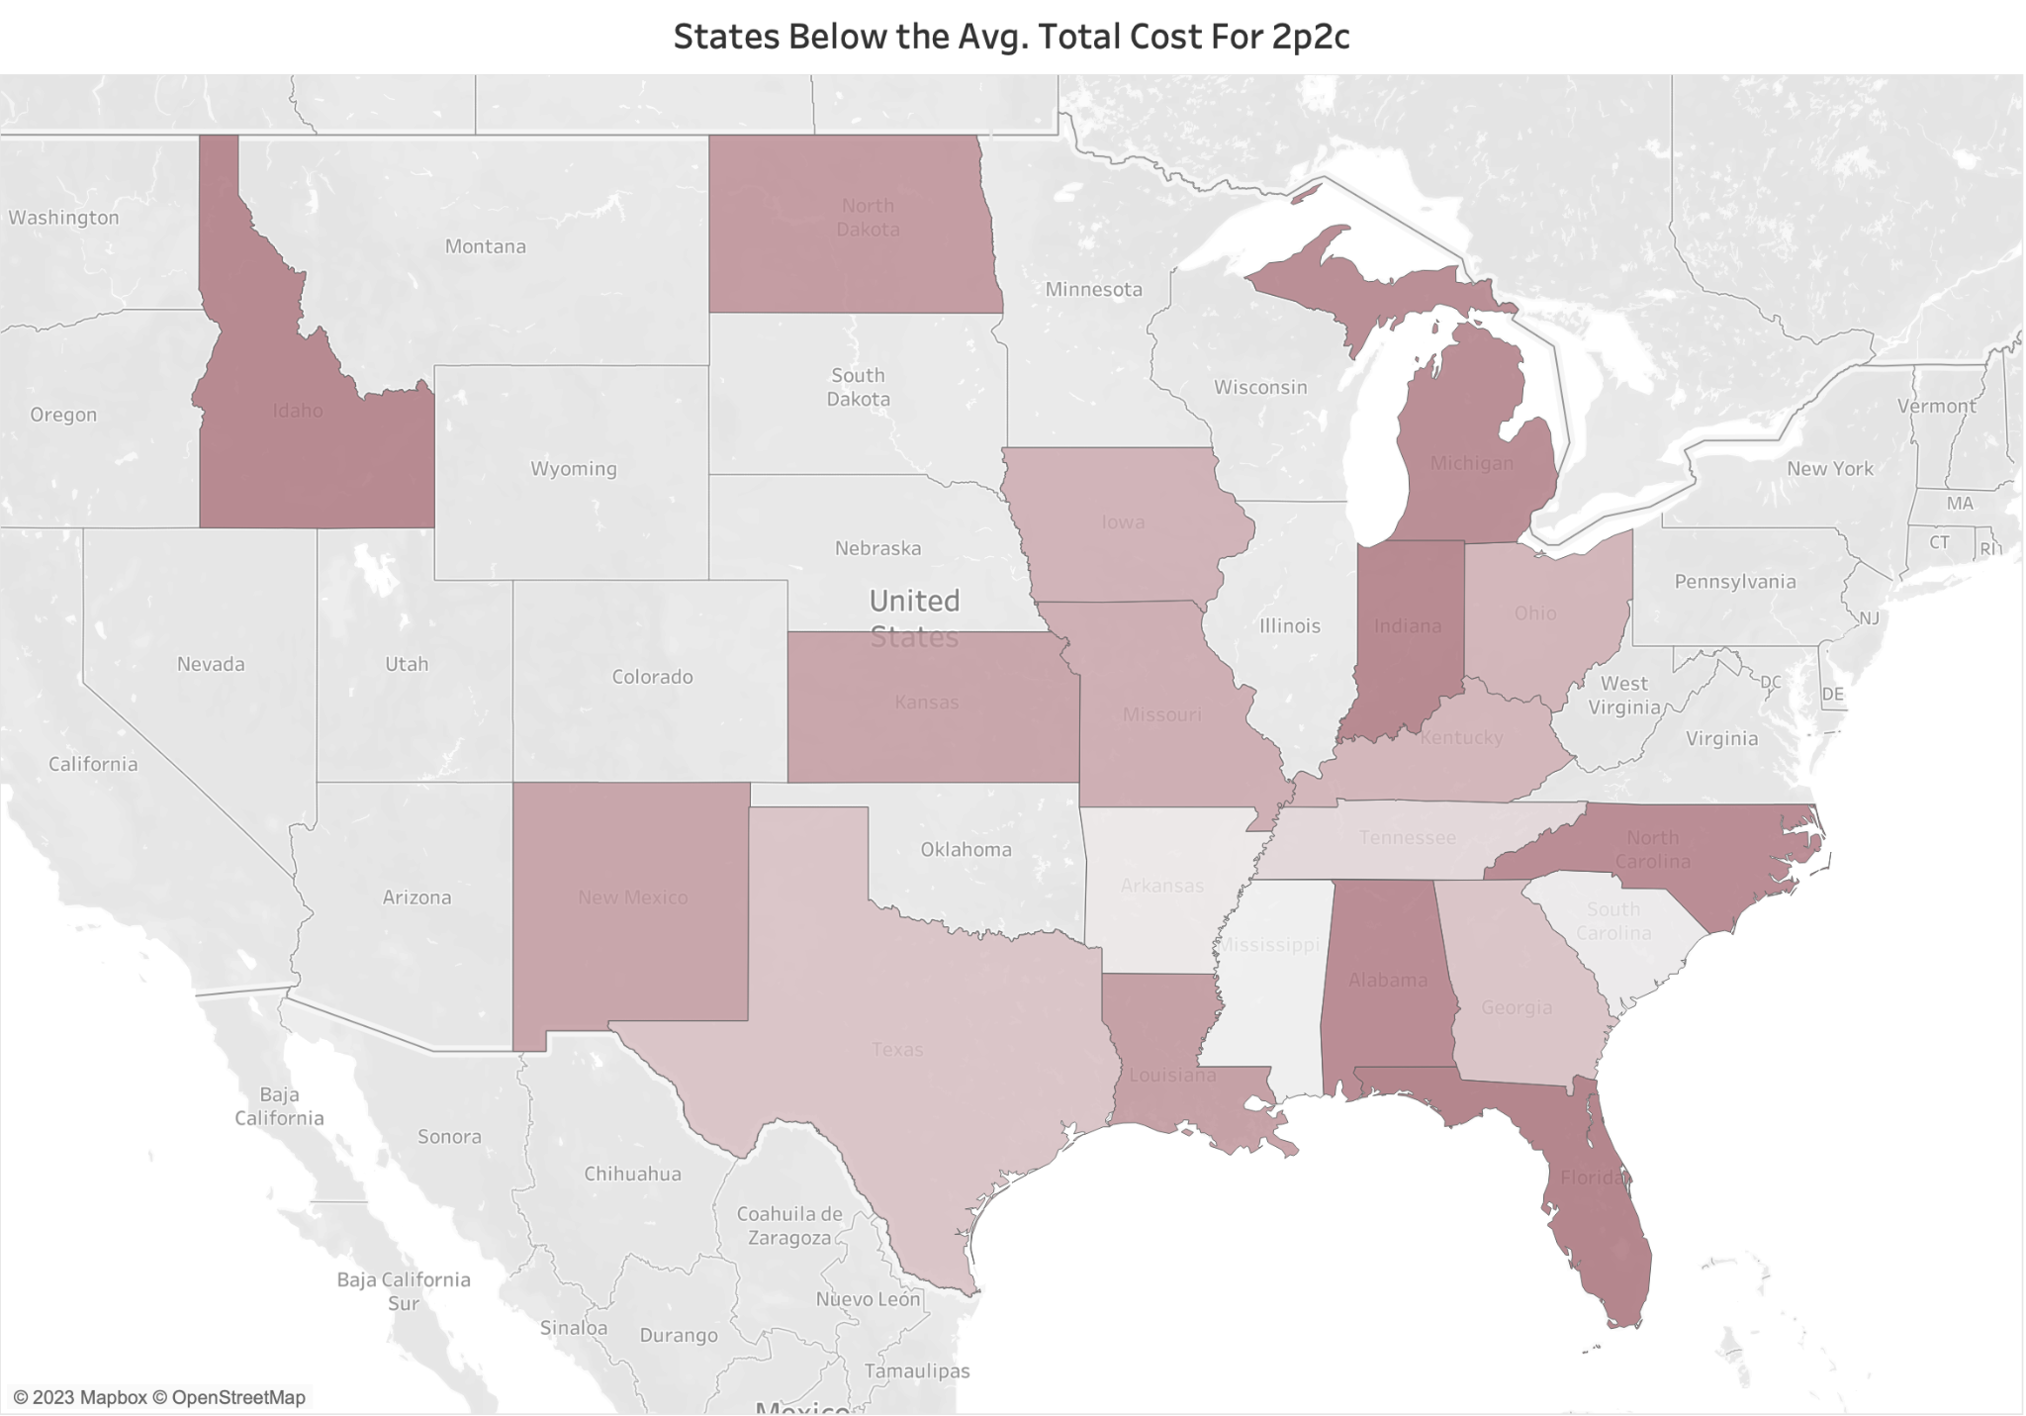
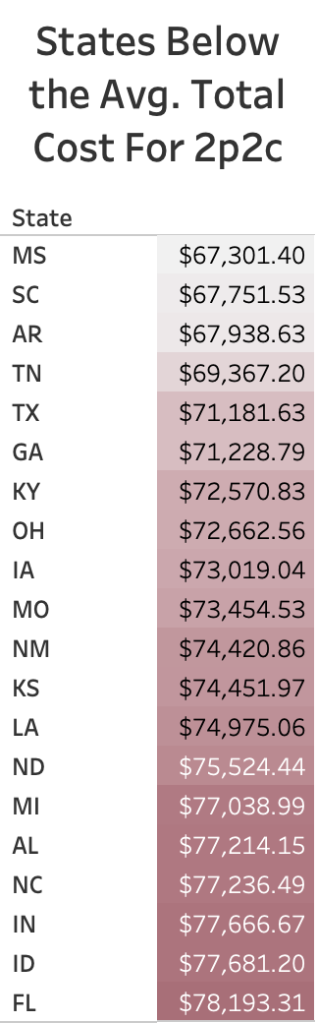
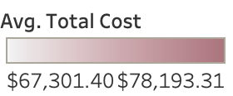
Avg. Total Cost for 2p2c:
$78,348.34

Slide 36
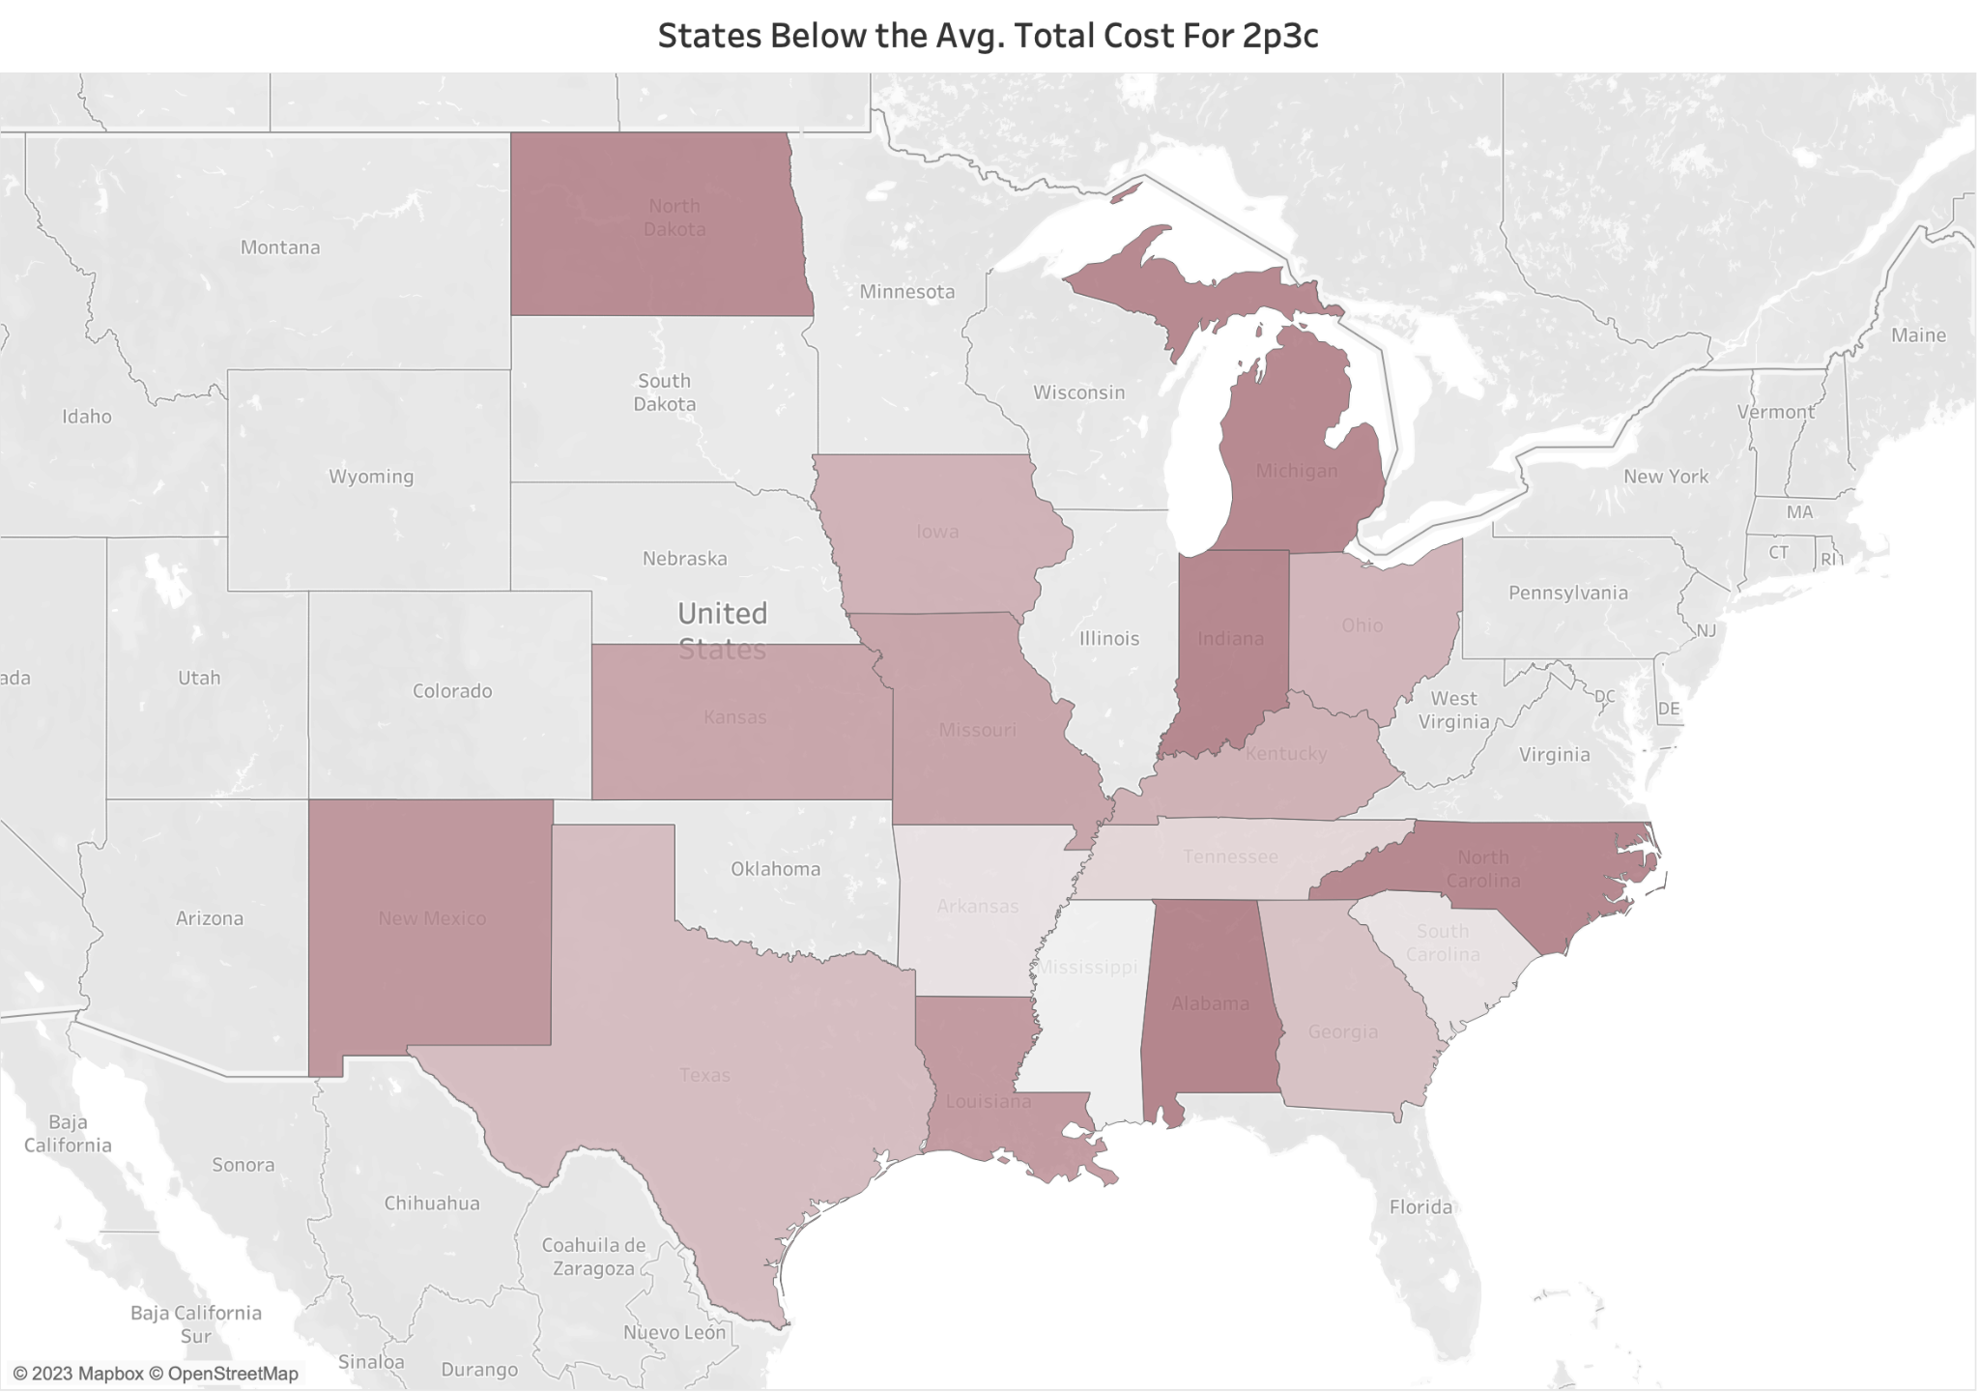
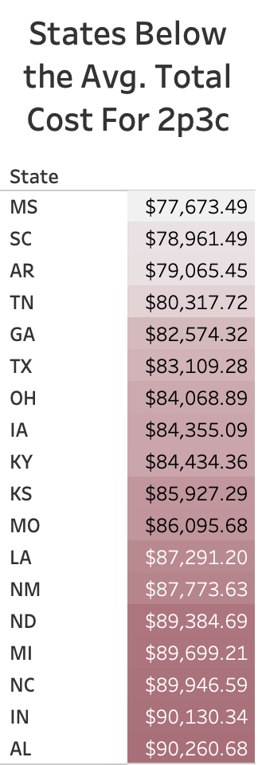
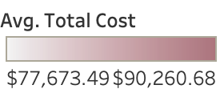
Avg. Total Cost for 2p3c:
$91,690.76

Slide 37
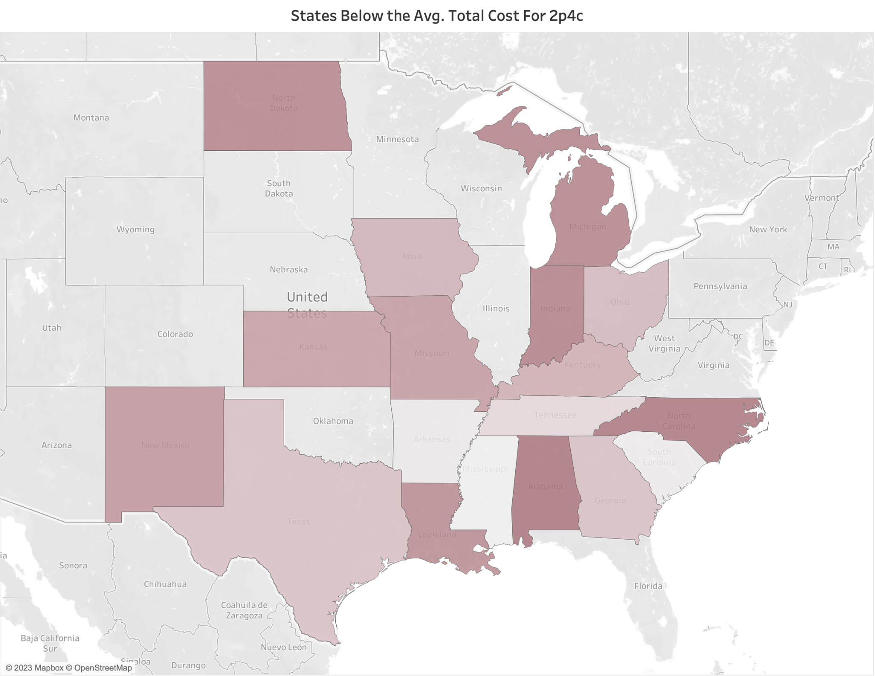
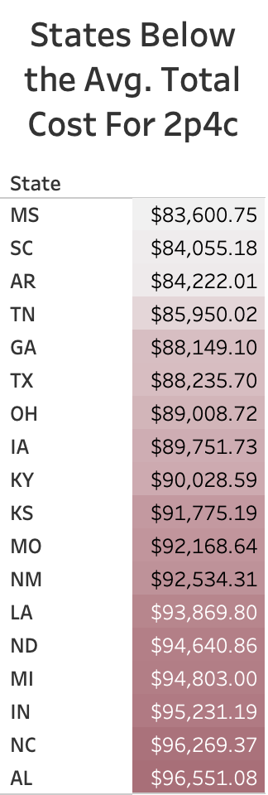
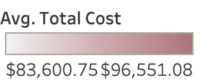
Avg. Total Cost for 2p4c:
$97,587.26

Slide 38
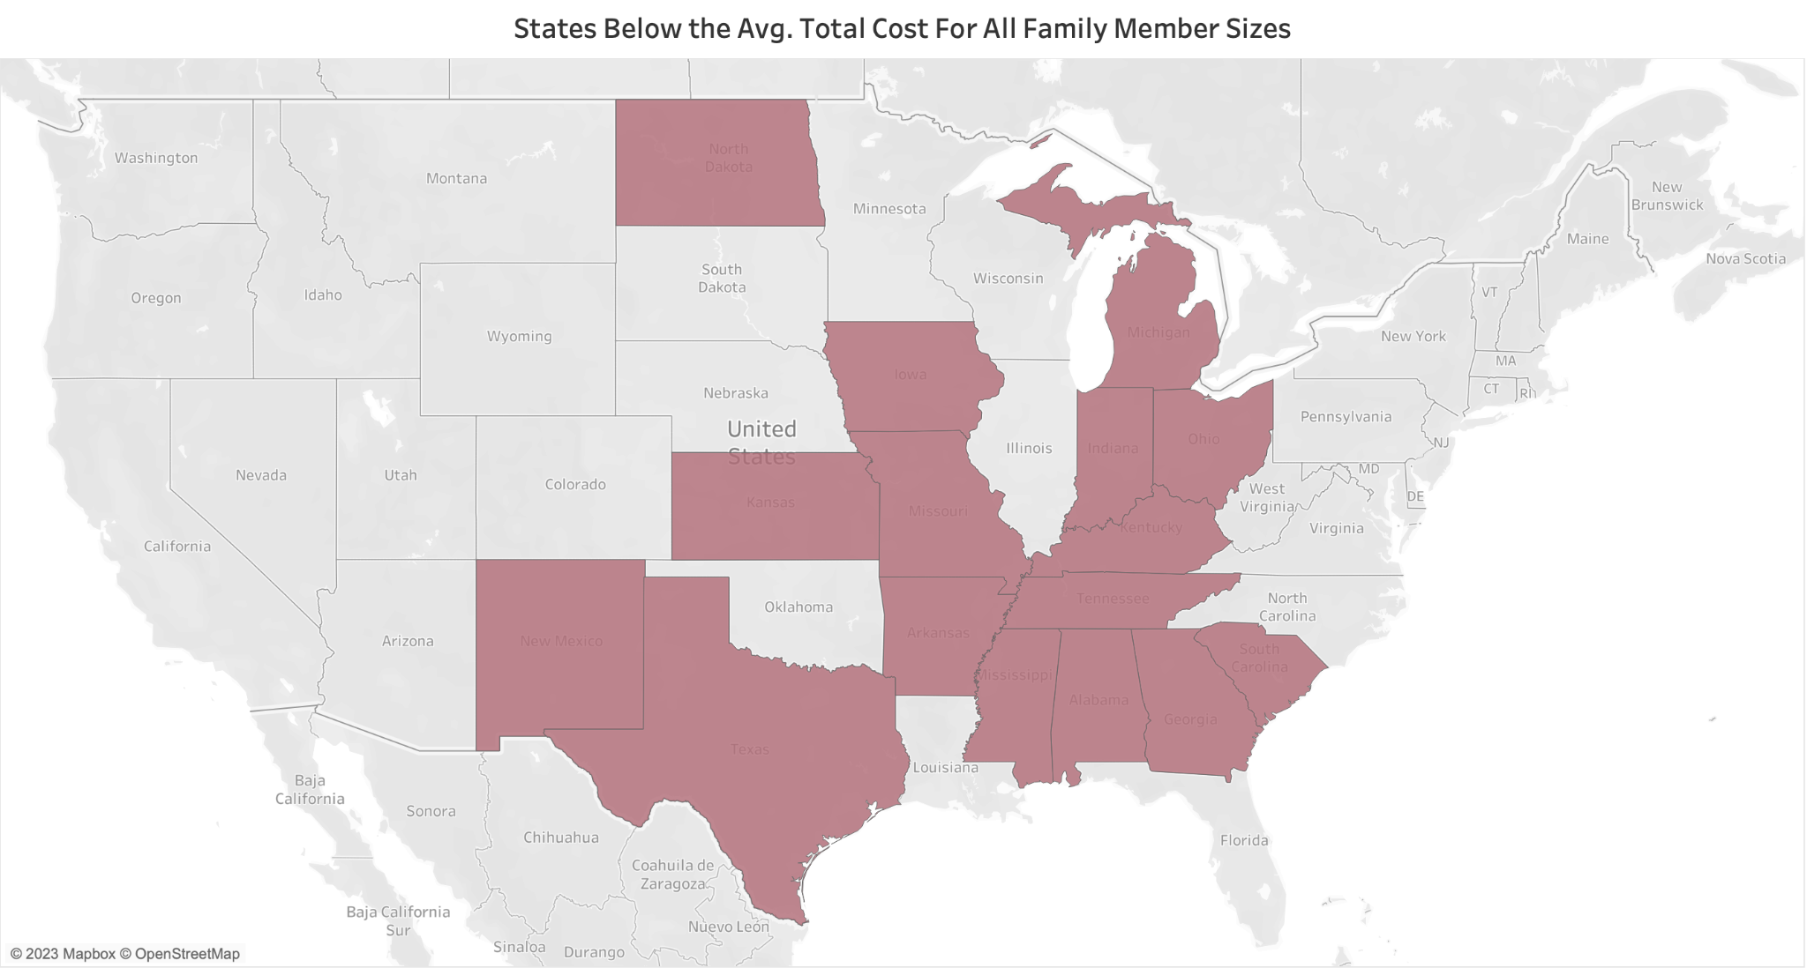

Slide 39
Which states are considered the most favorable to live in for individuals or families with the United States average median family income?

Slide 40

Average Median Family Income:
$68,309.20

Slide 41



Slide 42
Why These 7 States are Low Cost
Plenty of land
Low labor cost
No or low income tax
Agricultural state
Gas prices lower
Healthcare lower
Prices of goods are lower

Slide 43








Slide 44

MS Avg. Total Cost:
$61,360.99

Slide 45

AR Avg. Total Cost:
$61,491.89

Slide 46

SC Avg. Total Cost:
$62,104.87

Slide 47

TN Avg. Total Cost:
$62,871.11

Slide 48

TX Avg. Total Cost:
$64,795.40

Slide 49
Which counties in these states offer an appealing living cost for individuals and families, while remaining within the budget of the U.S. average median family income?

Slide 50

Metropolitan areas have higher population densities than nonmetropolitan and rural areas.
Higher population densities tend to drive up real property prices, as residents seek to occupy a limited amount of available land.
Residents of metropolitan areas also tend to have higher average incomes, making it important to compare their incomes in real terms.
Price levels tend to be lower in nonmetropolitan areas, even in states with higher-than-average prices overall.

Slide 51


Slide 52


Slide 53


Slide 54


Slide 55


Slide 56
05
Conclusions

Slide 57
Conclusions
#1
#2
Three highest individual costs are housing, transportation and healthcare.
Avoid high living costs by steering away from Hawaii, California, Massachusetts, the District of Columbia, and New Jersey.
#3
#4
The most economically favorable states, situated predominantly in the Southern and Midwest regions, particularly in rural areas.
Optimal living affordability is found in Texas, Arkansas, Mississippi, Tennessee, and South Carolina.

Slide 58
THANK YOU!
SOLD

Slide 59
Works Cited
https://www.kaggle.com/datasets/asaniczka/us-cost-of-living-dataset-3171-counties/data
https://datausa.io/profile/geo/sullivan-county-mo#:~:text=Median%20household%20income%20in%20Sullivan%20County%2C%20MO%20is%20%2446%2C964
https://texasview.org/why-texas-is-so-cheap/
https://www.clarionledger.com/story/news/2016/08/05/100-worth-more-mississippi-than-rest-us/88292510/#:~:text=%E2%80%9CThere's%20pretty%20much%20no%20place,cheaper%20general%20price%20of%20goods.%E2%80%9D
https://www.linkedin.com/pulse/why-land-so-cheap-arkansas-mazino-oyolo/
https://dividendsdiversify.com/why-is-living-in-tennessee-so-cheap/
https://www.boydteam.com/blog/what-makes-cost-living-so-low-south-carolina/#:~:text=This%20is%20the%20result%20of,per%20gallon%20in%20gas%20tax.
https://taxfoundation.org/data/all/federal/most-expensive-us-cities-and-metropolitan-areas-2020/

Slide 60
Works Cited Continued
https://www.unbiased.com/discover/banking/what-is-the-cost-of-living-in-mississippi
https://medium.com/@mazinooyolo/why-is-land-so-cheap-in-arkansas-f438e56d25be#:~:text=The%20median%20household%20income%20in,population%20lives%20in%20rural%20areas.
https://www.arkansasedc.com/news-events/arkansas-inc-blog/post/active-blogs/2023/01/11/arkansas-named-2-most-affordable-state-to-live-in-u.s
https://celadonliving.com/cost-of-living-in-south-carolina/#:~:text=Taxes%20are%20lower%20in%20South,the%20lowest%20in%20the%20country.
https://smartasset.com/taxes/south-carolina-property-tax-calculator#:~:text=South%20Carolina%20Property%20Taxes,-Photo%20credit%3A%20%C2%A9&text=If%20you're%20buying%20a,property%20tax%20payment%20of%20%24%20980.
https://dividendsdiversify.com/why-is-living-in-tennessee-so-cheap/
https://www.texasrealestatesource.com/blog/why-texas-is-a-cheap-place-to-live/#:~:text=Comparing%20to%20Other%20States,and%20relatively%20inexpensive%20housing%20options.

